Slide 1
Bellwork 9/27/16
Traduce (translate) (pg 50 & 51 help)
The (male) student is tall.
She is pretty.
You (singular) are short and lazy.
We are students from Mexico.
Where are you from?
I am very interesting but ugly.
School is large and both easy and hard.
They are some bad students.
You, Sr. Rivera are funny.

Slide 2
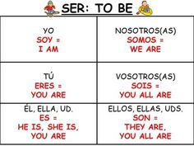
Tarea
https://www.polleverywhere.com/multiple_choice_polls/WEZkMg9rHfItZ4o
Pages 1.3-1.12 repaso

