Slide 1
Bellwork 9/29/16
Get out your bellwork sheet and wait silently.
Notes:
Draw the verb 6 pack for ser. Write all of the artículos of Spanish. What 2 things must an adjective and noun agree in?

Slide 2
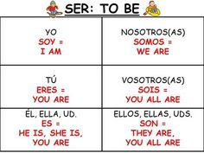
Bellwork 9/29/16
Artículos: el, la, los, las, un, una, unos, unas
What 2 things must an adjective and noun agree in? Number and Gender
Notes:
Draw the verb 6 pack for ser. Write all of the artículos of Spanish. What 2 things must an adjective and noun agree in?

Slide 3
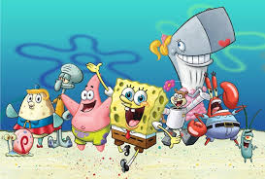
¿Cómos son?
Escriba 2 oraciones per persona. Utilice el vocabulario de capítulo 1. No repitas los adjetivos. (Don’t repeat the adjectives.)

Slide 4
Trivia
Examen repaso

